Slide 1
Means of Egress
Identify minimum required widths
Determine the clear width
Explain the rules for the means of egress

Slide 2
Historic Fire
Cocoanut Grove

Slide 3
Means of Egress
Chapter 7 of NFPA101
  Chapter 10 of IBC
Fundamental to life safety

Slide 4
Means of Egress Requirements
Level
  Not more than ¼ in
  More than ½ in change in level
Clearance
  7 ft 6 in
  6 ft 8 in
Slip resistant
No obstructions

Slide 5
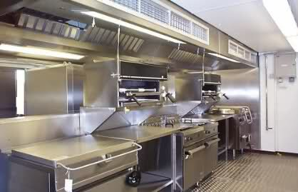
Decreasing Hazard
From corridor to a room
From one room to another room
Through kitchens
Through mechanical rooms
Rated enclosure to unprotected space
Enclosed stair to lobby
Stairs directly to outside

Slide 6
Minimums
Doors and Corridors
Stairs
Access: 36 in
Doors:
  Clear width
  28 in
  32 in
Cannot decrease in direction of travel
44 in
  Exception 36 in
56 in
Cannot decrease in direction of travel

Slide 7
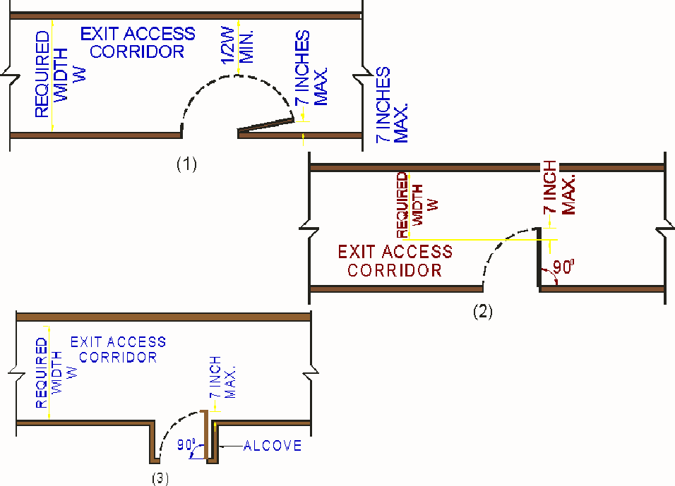
Clear Width
Doors
Stairs
Corridors

Slide 8
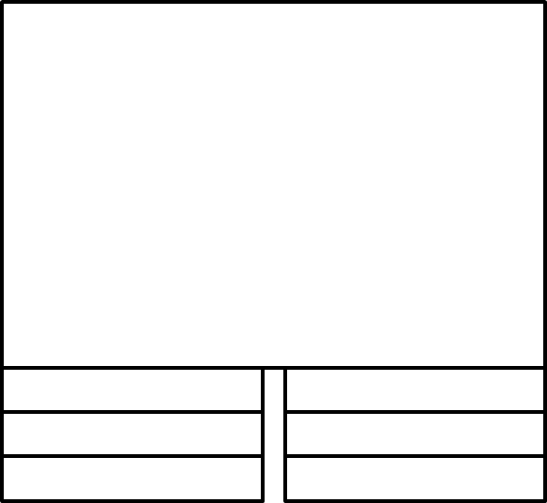
Landings
No decrease in width
Length equal to width of stairs
  48 in
At doors

